Slide 1

UCF Coding Boot Camp
March 2016-September 2016
UCF0328FSF (M/W) 6:30pm
UCF0329FSF (T/TH) 6:30pm
ALL (Saturday) 10:00am

Slide 2
UCF Coding Boot Camp
Slack @jmedina your Wifi Log-in and Password
Sign your Student Acknowledgement Form and Turn-In

Slide 3
Welcome
Introduction to UCF & the UCF Coding Boot Camp
Introduction to your Support Team
Program Expectations
Support Services
Career (Outcomes) Support
Our Curriculum
Let’s get started

Slide 4
Intro to UCF
UCF was founded in 1963 as Florida Technological University
In 1978 the name changed to University of Central Florida
Today UCF counts 12 colleges and 212 degree programs in total
UCF is the nation’s second-largest university with 63,002 students
Notes:
Speaker: Todd - welcomes students to UCF, background (3 to 5 mins)

Slide 5

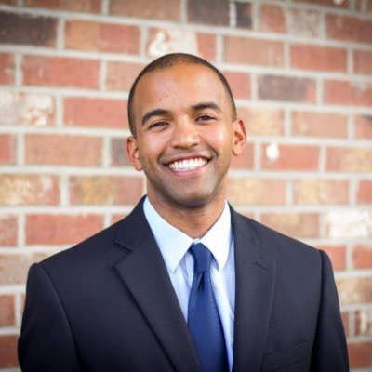
Your Support Team
Academic Support team includes:
Instructor: Eric Silvay
TA’s: Victor Cabieles & Michael Marrow
Student Success: Ricky Cuellar
Goal is to make you successful
Day to Day support.
Career Services: Jonathan Medina
Comprehensive Career Coaching and Preparation
Integrated Employer Engagement and Access
Notes:
Speaker: Jonathan
- My job is to make you successful
Student success will be handling all logistical questions for this class, we'll talk about what you'll do if you miss a class, if you aren't sure who to talk to about a question you have or aren't
Career director responsible for all career placement and employer engagement

Slide 6
Expectations
Item | Policy
Attendance | 95% attendance (May be absent a maximum of 4 classes) Must have written approval for absence Weather Policy
Homework | 90% Completion (You can miss 2)
Projects | 100% Completion of your portfolio
Time outside of class | Depends on you, we recommend 10 hours a week
Tracking Tools available On Wednesday
Notes:
Speaker: Jonathan
Talking points: This is the part where we have to be real serious
Attendance policy = we believe you’ll learn through being in class, that’s why we’re going to be here teaching class. If you don’t come to class, you’re not going to learn
Weather = above all, be safe. I will be slacking updates if we ever think weather is going to be a problem but we’ll take it on a case-by-case basis and it will be specific for this class.
Homework policy = do your homework, practice what you’ve studied in class, without doing the coding you won’t become a coder
Projects = Your portfolio is going to be the bread and butter of getting hired, when you go into a coding interview and you say you’re a coder, you can’t BS that. You either have stuff to show for it or you don’t. Do your projects so that you have stuff to show for it.

Slide 7
Support Services
GitHub
Access to Lectures, Homework, Class Calendar
Live Office Hours
45 minutes prior to class and 30 minutes after
Virtual Office Hours
Google Hangouts (Scheduled for challenging topics)
Surveys
Weekly feedback on your experience
Notes:
Speaker: Jonathan

Slide 8

Our Approach to Career Services
We are your personal trainer.
Our aid will include Career Coaching, Portfolio Review, & Access to Employers.
We will help you access the tools needed to achieve the career, but we cannot achieve it for you.
This is a partnership.
Notes:
Speaker: Jonathan
You are given the opportunity to participate in experiential learning with employers providing access to new employment opportunities.
You’ll have access to career coaching, recruitment support, and an engaged network of hiring partners.
We have a real world approach - You’ll use of tools like GitHub, Slack, Trello, and more throughout the course
CS Fundamentals (not just coding, but how to think) – Dictated by our employer partners

Slide 9
Our Approach to Career Services
Curriculum that combines coding and career related topics
Using tools that work in the real world
Access to the“hidden” job market
Employer Network
Dynamic curriculum and class experience
Curriculum content driven by market demand
Accountability
Notes:
Speaker: Jonathan

Slide 10
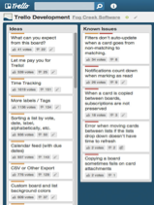
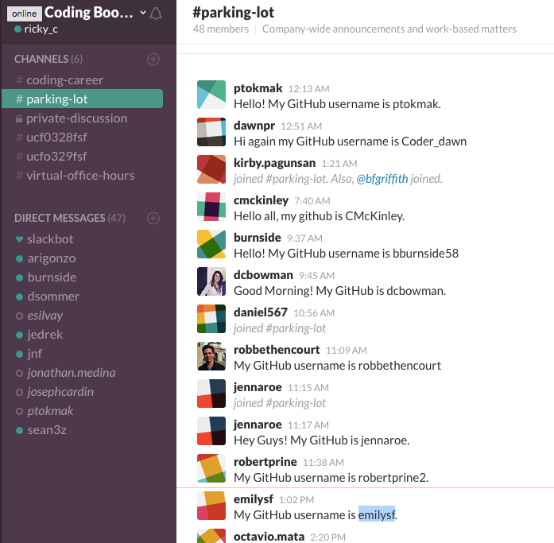
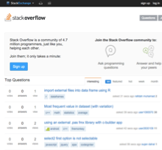
Tools That Work
Trello
Slack
Stack Overflow
Notes:
Trello is the most often used software by tech companies to track projects and process flows.
We get you used to it by using this for yourt job search.
Slack is most often used communication tool – we use this for office hours, etc.

Slide 11
Hidden Job Market
Job seekers must go beyond traditional job posting sites
80% of job openings are filled by referrals
Attacking this ‘hidden market’ will get you the most leads
Referrals > Leads > Interviews > Employment
Our Employer Network will be a resource to you and serve as your potential gateway to that ‘Hidden Market’.

Slide 12



























Employer Partners and Speakers
Notes:
Our engaged employer network

Slide 13
The Job Market is not Static &
Neither is your Curriculum
Lectures + Workshops
Customizable tools and templates
Personal job matching
Career coaching (1:1)
Soft Skills
Projects and Internships with our hiring partners
In-Class Guest Speakers
Demo days
Private company tours
Notes:
We will teach soft skills such as interviewing, how to build and develop your social profile, resume, GitHub profile, and more. He/She will also help you to connect with our network of employers once you have the skills necessary to qualify for opportunities. We will provide support after graduation to help you land your job. We will provide tools, templates and more.

Slide 14
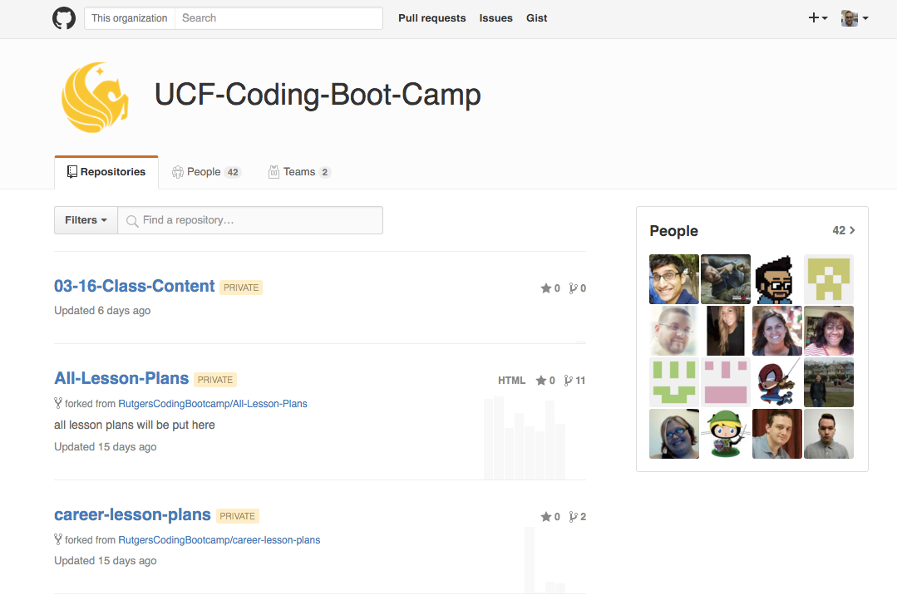
Our Curriculum
Notes:
Intro to CLO - Pavan

Slide 15
Our Curriculum
Browser Based Technologies
Deployment
Database Management
Service Side Development (Node.js & PHP)
Computer Science applied to JavaScript
Quality Assurance
CMS & SEO
Notes:
Browser Based Technologies
Deployment
Database
Service Side Development (Node.js & PHP)
Computer Science applied to JavaScript
Quality Assurance
SEO

Slide 16
Thank You!
Let’s get started!…

